Slide 1
Simple Text Editor
Pranav S
Pranav Tejas K
Raj P Kamble

Slide 2
Scope
Text editors are superior for writing code. It will give you the cleanest results if you’re writing and editing the code. A good text editor will even be able to help you format your text according to specific programming language, colour code your file and even auto complete your code.

Slide 3
What is a text editor?
A text editor is a type of computer program that edits plain text. Such programs are sometimes known as notepad software (e.g: Windows Notepad).
Text editors are provided with OSs and software development packages, and can be used to change files such as configuration files, documentation files and programming language source code.

Slide 4
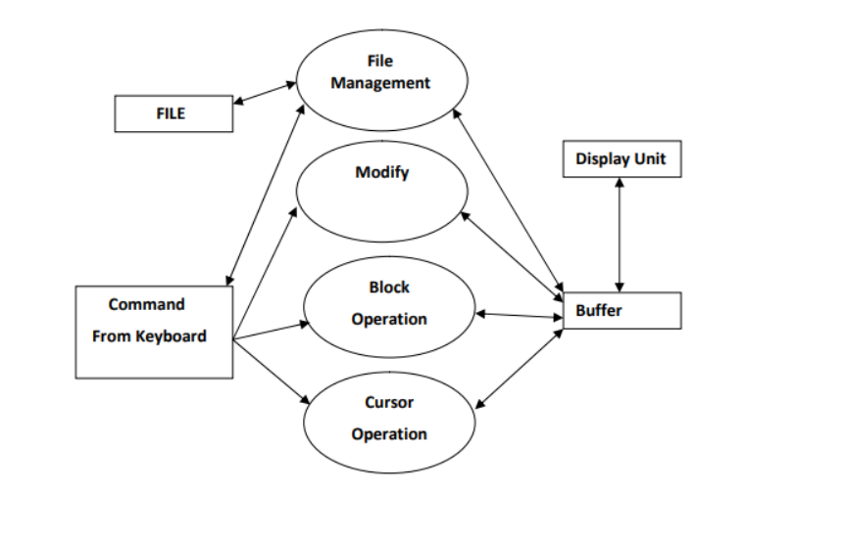
Architecture of the programme

Slide 5
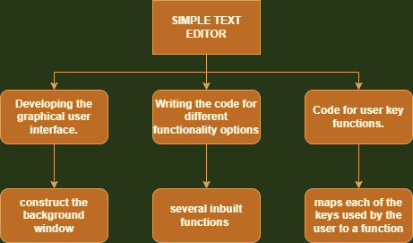
WBS

Slide 6
Introduction
Microsoft Windows systems come with the simple Notepad, though many people—especially programmers—prefer other editors with more features.
Under Apple Macintosh’s classic Mac OS there was the native TeachText later replaced by SimpleText in 1994.
Some text editors can edit unusually large files such as log files or an entire database placed in a single file. Simpler text editors may just read files into the computer's main memory. With larger files, this may be a slow process, and the entire file may not fit.

Slide 7
Basic Function
Open and save as –
Text Editor opens the file. Use the Save As command in the file menu to overwrite the original file. The original file now contains the contents of the previous version.
The Save As feature in Word, Excel, and PowerPoint has been replaced by Save a Copy. To save a copy of a file

Slide 8
Functions
Cut-
The Cut feature allows you to remove selected text from the document and temporarily place it on the Clipboard.
Copy-
The Copy feature allows you to copy selected text from the document and temporarily place it on the clipboard.
Paste-
The Paste feature allows you to select any of the collected items on the clipboard and place them in the same or another document.

Slide 9
Bold and Italics
To make text bold, select and highlight the text first. Then click the bold button
To make text italic, select and highlight the text first. Then click the Italic button

Slide 10
Print
Open the document in Text Editor. Choose Print from the File menu
From the print dialog box ,we can select the format of the paper (A4,A3)
Further select is it’s a colour or a black and white print and press the print button

Slide 11
Undo and Redo
Undo and redo :–
As with word processors, text editors provide a way to undo and redo the last edit, or more. Often there is only one level of edit history remembered and successively issuing the undo command will only "toggle" the last change. A separate redo command will cycle the edits "forward" toward the most recent changes.

Slide 12
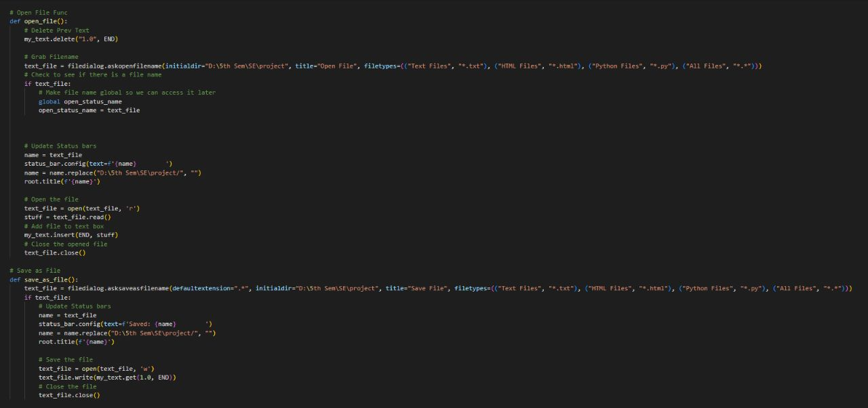
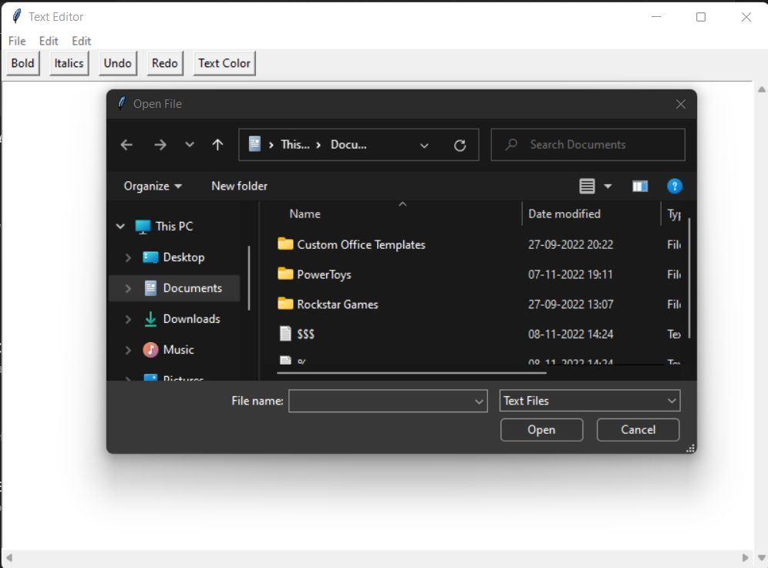
Code

Slide 13
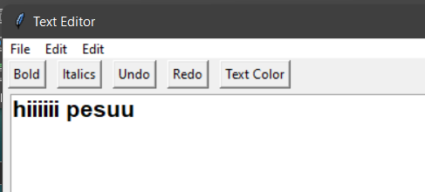
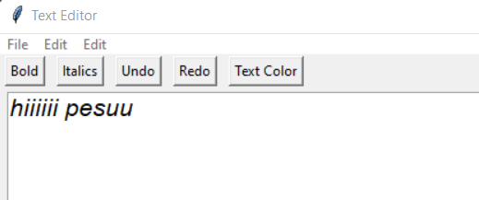
Screenshots

Slide 14
So we would like to conclude by saying that a text editor helps you develop from scratch, letting you customize your design according to your wish.

